Slide 1



JavaScript
Lecture 1
Introduction to JavaScript
Notes:
Facilitator to welcome the students by saying: Welcome to the JavaScript Course. This course is designed specially for you.

Slide 2
Session Objectives
By the end of the session, we will be able to:
Differentiate between HTML, CSS and JavaScript
List the characteristics and uses of JavaScript
Identify the usage of JavaScript in Web Development
Gain understanding about the basic syntax and structure of a JavaScript program

Slide 3
Differentiate between HTML, CSS and JavaScript
Identify the usage of JavaScript in Web Development
Basic syntax and structure of a JavaScript program

Slide 4
What is JavaScript?

Slide 5
JavaScript is a high-level programming language that is primarily used for web development. It allows developers to add interactive elements, dynamic content, and behavior to websites.
JavaScript is a versatile language that can be used both on the client-side (in the web browser) and on the server-side (with the help of technologies like Node.js)

Slide 6
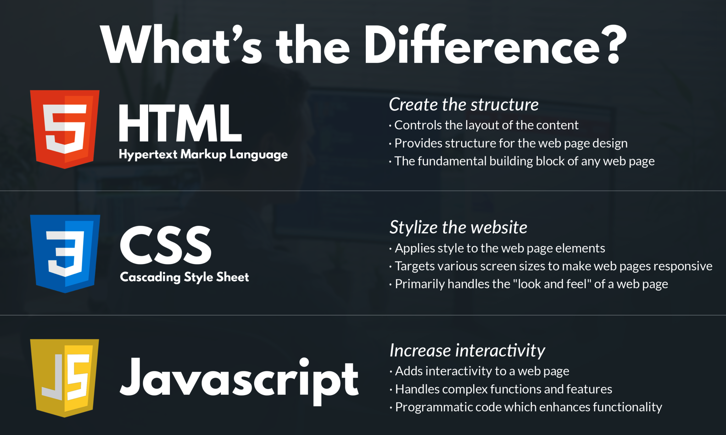
Difference between HTML, CSS, and JavaScript

Slide 7
Differentiate between HTML, CSS and JavaScript
Identify the usage of JavaScript in Web Development
Basic syntax and structure of a JavaScript program

Slide 8
Key Features and Uses of JavaScript

Slide 9
Key Features and Uses of JavaScript
1
All popular web browsers support JavaScript because they provide built-in execution environments.
2
JavaScript follows the syntax and structure of the C programming language. Thus, it is a structured programming language.
3
JavaScript is a weakly typed language, where certain types are implicitly cast (depending on the operation).
4
JavaScript is an object-oriented programming language that uses prototypes rather than using classes for inheritance.

Slide 10
Key Features and Uses of JavaScript
5
It is a light-weighted and interpreted language
6
It is a case-sensitive language
7
JavaScript is supportable in several operating systems including, Windows, macOS, etc.
8
It provides good control to the users over the web browsers
Notes:
Say: Overall, JavaScript is a versatile and essential programming language for web development, enabling developers to create interactive and dynamic websites, build server-side applications, and develop mobile apps

Slide 11
Do You Know What was JavaScript initially called??

Slide 12
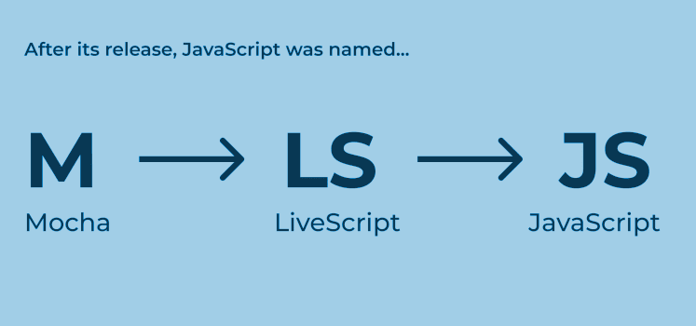

Slide 13

History of JavaScript
JavaScript was created by Brendan Eich, an American computer programmer in just 10 days while he was working at Netscape Communications Corporation (now known as Mozilla) in 1995. It was originally named 'Mocha' but was quickly renamed to LiveScript and finally to JavaScript due to marketing reasons and its potential association with the growing popularity of Java at that time.
The motivation behind creating JavaScript was to add interactivity and dynamic functionality to web pages, which were predominantly static at that time. The language was designed to be lightweight and easy to learn, allowing web developers to write scripts that could be executed on the client-side, directly within web browsers.

Slide 14
History of JavaScript
In 1996, Netscape submitted JavaScript to the European Computer Manufacturers Association (ECMA) to standardize the language.
Over the years major versions of ECMAScript have been released, introducing new features and improving the language's capabilities.
This process resulted in the creation of ECMAScript, which is the official name of the JavaScript. Its first edition, ECMAScript 1, was released in 1997.
Some notable versions include ECMAScript 3 (1999), ECMAScript 5 (2009), ECMAScript 6 (ES6) or ECMAScript 2017, ECMAScript 2018, and ECMAScript 2019.

Slide 15
History of JavaScript
JavaScript's popularity soared as web development expanded, and it became a fundamental technology for building interactive websites and apps
In recent years, JavaScript has boomed, with modern frameworks and libraries such as React.js, AngularJS, Vue.js, and Node.js gaining prominence.
5
6
7
8
The introduction of AJAX (Asynchronous JavaScript and XML) in the early 2000s further propelled JavaScript's usage
These tools have contributed to JavaScript's expansion into server-side, desktop application, and even mobile app development through technologies like React Native and Ionic.

Slide 16

Applications of JavaScript
Client-side validation
Dynamic drop-down menus
Displaying date and time
Displaying pop-up windows and dialog boxes (like an alert dialog box, confirm dialog box and prompt dialog box)
Displaying clocks etc

Slide 17
Session 1 Activity 1
Time for an activity.

Slide 18

JavaScript in Web Development
JavaScript is primarily used for creating dynamic and interactive elements on websites. Here are some key points about JavaScript in web development:
Client-Side Language: JavaScript is primarily executed on the client-side, meaning it runs in the web browser of the user. It enables developers to add interactivity, manipulate the DOM (Document Object Model), and respond to user actions without the need for server-side communication.

Slide 19
JavaScript in Web Development
Web Browsers: JavaScript is supported by all modern web browsers, including Chrome, Firefox, Safari, and Edge. This widespread support makes it a reliable choice for building web applications.
DOM Manipulation: JavaScript allows developers to access and manipulate the HTML document's elements, structure, and styles using the DOM API. With JavaScript, you can dynamically change content, modify styles, create and remove elements, handle events, and more.

Slide 20
JavaScript in Web Development
Event Handling: JavaScript provides a mechanism to handle user interactions such as button clicks, form submissions, mouse movements, and keyboard events. You can write event handlers to respond to these events and trigger appropriate actions or behaviors.

Slide 21
JavaScript in Web Development
AJAX and Fetch: JavaScript enables asynchronous communication with web servers using techniques like AJAX (Asynchronous JavaScript and XML) and the Fetch API. These features allow you to retrieve data from the server without refreshing the entire web page, resulting in a more interactive and responsive user experience.

Slide 22
JavaScript in Web Development
Frameworks and Libraries: JavaScript has a rich ecosystem of frameworks and libraries that simplify web development. Popular frameworks such as React, Angular, and Vue.js provide reusable components and efficient ways to manage the application state.
Form Validation: JavaScript can be used to validate user input on forms before submitting them to the server. You can perform various validations such as checking for required fields, validating email addresses, enforcing password strength, and more

Slide 23
JavaScript in Web Development
Animations and Effects: JavaScript, combined with CSS, enables the creation of animations and visual effects on web pages. You can animate elements, create transitions, and apply dynamic effects to enhance the user interface.
Browser APIs: JavaScript provides access to a wide range of browser APIs that allow developers to leverage device features. These APIs include the Geolocation API, Web Storage API, Canvas API, Web Audio API, and more, enabling web applications to utilize various capabilities of the user's device.

Slide 24
JavaScript in Web Development
Third-Party Integration: JavaScript allows integration with third-party APIs and services, such as social media platforms, payment gateways, mapping services, and more. This integration enables developers to extend the functionality of their web applications by leveraging existing services.
JavaScript's versatility and widespread adoption make it a powerful tool for web development. It is constantly evolving, with new features and improvements being added regularly.

Slide 25
Differentiate between HTML, CSS and JavaScript
Identify the usage of JavaScript in Web Development
Basic syntax and structure of a JavaScript program

Slide 26
Let’s take a look at basic syntax and Structure of a JavaScript program

Slide 27

Basic Syntax and Structure of a JavaScript Program
The basic structure of JavaScript Program is:
//HTML Code
<HTML>
<BODY>
<SCRIPT>
document.write(" WELCOME TO SUNSTONE ");
//This is Visible in Console Window
</SCRIPT>
</BODY>
</HTML>
Output in Console Window:
WELCOME TO SUNSTONE

Slide 28
Running JavaScript Code
To run JavaScript code, you can choose between a web browser environment or a Node.js environment. Here's a brief explanation of how to run JavaScript code in each of these environments:
Running JavaScript in a Web Browser:
To run JavaScript code in a web browser, you have a few options:
Inline Script: You can include JavaScript code directly within an HTML file using the <script> tag.
You can open the HTML file in a web browser, and the JavaScript code will be executed. You can view the output or errors in the browser's developer console (accessible through the browser's developer tools).

Slide 29
Running JavaScript Code: Inline Script
Here's an example:
// HTML Code
<HTML>
<HEAD>
<TITLE> JavaScript Page </TITLE>
</HEAD>
<BODY>
<H1> JavaScript </H1>
//This will be visible in browser page
<SCRIPT>
// JavaScript code goes here
console.log(' Hello, World! ');
</SCRIPT>
</BODY>
</HTML>

Slide 30
Running JavaScript Code
External Script: Alternatively, you can write your JavaScript code in a separate .js file and include it in an HTML file using the <script> tag's src attribute.
<HTML>
<HEAD>
<TITLE> JavaScript Page </TITLE>
<SCRIPT SRC="script.js"> // External JavaScript
</SCRIPT>
</HEAD>
<BODY>
<H1> JavaScript </H1>
//This will be visible in browser page
</BODY>
</HTML>
Notes:
Say: In this example, the JavaScript code is written in a file named script.js. When you open the HTML file in a browser, the browser will load and execute the JavaScript code from the external file.

Slide 31
Running JavaScript Code
Running JavaScript in Node.js:
Node.js is a runtime environment that allows you to run JavaScript code outside of a web browser. Here's how you can run JavaScript code in Node.js:
Create a JavaScript File:
Create a new file with a .js extension, such as script.js, and write your JavaScript code in it.
node script.js

Slide 32
Running JavaScript Code
Execute the File with Node.js:
Open a terminal or command prompt, navigate to the directory where your JavaScript file is located, and run the following command:
Replace script.js with the name of your JavaScript file. Node.js will execute the JavaScript code, and you'll see the output or errors in the terminal.
Whether you choose to run JavaScript code in a web browser or a Node.js environment depends on your specific use case. Web browsers are suitable for client-side web development, while Node.js is commonly used for server-side applications and command-line tools.

Slide 33
Differentiate between HTML, CSS and JavaScript
Identify the usage of JavaScript in Web Development
Basic syntax and structure of a JavaScript program

Slide 34
Session 1 Activity 2
Time for an activity.

